Slide 1
Review of previous classes
1. Nanotechnology in upward motion: next future of science and technology is nanotechnology
2. Constructive - Destructive interference by thin films
3. Non-Reflective Surfaces
4. Super-Hydro-Phobicity
5. Self-Cleaning
Nano in Histroy
The Localized Surface Plasmon Resonance
DICHROISM
Development of nanoscience and technology
Diversity of nano field
Surface to volume atoms of Cuboctahedral system
M(K) = (1/3)*(10K³+15K²+11K+3), K = No. of shell
N_{K} =10K² + 2, Every shell contains number of shell
SIZE EFFECT
Quantum Effect
To-Down Method of Preparation
Ball mill, Thermal, Arc discharge, Laser ablation etc.
LITHOGRAPHIC METHOD
Bottom-UP method
HOW TO REALIZE THE NANOPARTICLE

Slide 2
Size Spectrum of Environmental Particles
Nanoscale contaminants in
water and air (little is known)
H
2
O
Hemoglobin
Virus
Microbial
Cells
Protozoa
(0.2 nm)
(7 nm)
(10-100 nm)
(~1 µm)
(>2 µm)
Conventional
Filtration
Microfiltration
Adenovirus 75 nm
Ultrafiltration
Reverse
Bacteriophage 80 nm
Osmosis
Influenza 100 nm
E. Coli
1000 nm
0.1 nm
1 nm
10 nm
100 nm
1 µm
10 µm
100 µm
Fullerenes, nanotubes
PM _{2.5}
Aerosols
Pollens
(10-100 µm)

Slide 3
What are the materials of nanotech?
Nanostructure
Size
Example Material or Application
Clusters, nanocrystals, quantum dots
Radius:
1-10 nm
Insulators, semiconductors, metals, magnetic materials
First of all one has to know the particle is in nano scale or not
Other nanoparticles
Radius:
1-100 nm
Ceramic oxides, Buckyballs
Nanowires
Diameter: 1-100 nm
Metals, semiconductors, oxides, sulfides, nitrides
Nanotubes
Diameter: 1-100 nm (or) in micron size
Carbon, including fullerenes, layered chalcogenides

Slide 4
Thanks God who began his immense work of creation by giving to heaven and earth this wonderful gift of light, which has vital importance for the world. Even today when we refer to the birth of a child we still say “He saw the light of the day”.
The light is a primary object which helps to see this beautiful world. However, we are not so lucky enough to see all the beautiful tiny creation of the nature due to our limitation of eye resolution (~0.35mm).
In modern science there are various microscope techniques to increase the size of tiny particles to see and understand the beautiful world.
RESOLUTION: ability to distinguish closely spaced points as separate points.
RESOLUTION LIMIT: smallest separation of points which can be recognized as distinct.
RESOLVING POWER: resolution achieved by a particular instrument under optimum viewing conditions.
resolving power of the eye
Maximum magnification= -----------------------------------
resolving power of the microscope
But again question, How small you can see by the optical microscope??

Slide 5
Ernst Abbe: 1840 - 1905
The fundamental nature of light poses limits on the detail that can be resolved. Abbe (1893) showed that the smallest resolvable distance is about 1/2 the wavelength of light used. Thus, 1/2 the wavelength of the radiation used is the ultimate resolving power of any instrument.
John William Strutt (Lord Rayleigh): 1842 - 1919
The Rayleigh criterion defines the resolution (R) of light microscope as:
R=d/2=0.61λ/nsinθ
where λ is the wavelength of the radiation,
n is the refractive index of the view medium and,
θ is the semi-angle of collection of the magnifying lens.
X-ray: Cu kα: λ=0.154 nm, Electron: 200 kV, 0.00251 nm
Due to the limitations of the values α, λ , and n, the resolution limit of a light microscope using visible light is about 200 nm. The shortest wavelength of visible light is blue (λ = 450nm), θ for the best lens is about 70° (sin θ = 0.94), and the typical high resolution lenses are oil immersion lenses (n = 1.56): R=187 nm
(Numerical aperature=N.A. = nsinθ)

Slide 6
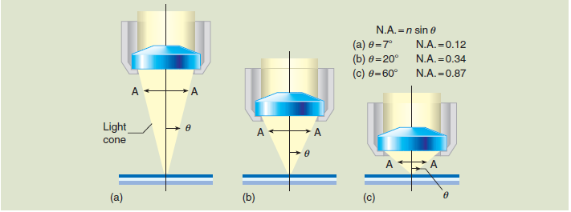
Three different lens configurations highlighting the numerical aperture of microscopes are compared. The closer the aperture is to the sample the larger the angle enclosing the lens becomes. From the equation, N.A. is proportional to the sine of angle θ. For θ = 10° (a long focal length), N.A. = 0.17; for θ = 40°, N.A. = 0.64; and for θ = 60° (a shorter focal length), N.A. = 0.87. Small N.A.s translate into low resolution. High N.A. translates into high resolution.
dsinθ=λ, θ=λ/d, Angular resolution = 1.22λ/2N.A. = 1.22λ/D=0.61λ/N.A.
Spacial resolution = f x angular resolution = 1.22λf/D

Slide 7
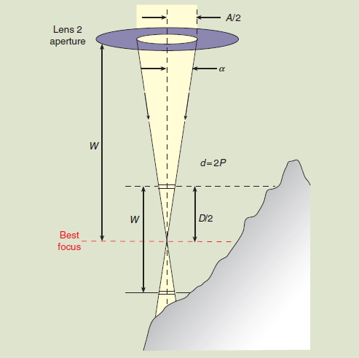
A schematic depicting depth of focus is shown. D_{Focus} depends on the numerical aperture.
α = Angle of diversion,
tanα = R₀ /W ~ α
R₀ = Aperature radius
W = Working Distance
D_{Focus} = 0.2/αM µm
M = Magnification= i/o
i= image distance
O=object distance
D_{Focus} α λ/(N.A.)²
D_{Field} = 0.61λ/n sinα tanα

Slide 8
Key modern technologies, for example, television, computer, flash memory for digital camera results from the knowledge we have gained from electrons. It is hardly to think what our daily life looks like without electrons.
Electrons not only have huge impacts on our daily life, but also provide
us with a key to explore nano-world which attracted tremendous attention in
recent years. Electrons will play a key role for us to gain knowledge from the nano-world and develop new science and technology (now called Nanoscience and nanotechnology).
Electron Microscope

Slide 9
The relation between the wavelength (λ) of an electron of mass, m, moving at a velocity, v, is given by the de Broglie wave equation:
h = Planck's constant (6.624 X 10-27 erg-second)
An electron of charge e(1.6x10⁻¹⁹ coulomb), and mass m (9.11x10⁻ ²⁸ gm), when passing through a potential difference of V volts (expressed in joules/coulomb), has a kinetic energy:
1/2mv²=eV= hc/λ,
Since, 1 joule = 10⁷ dynecm = 10⁷ cm²gm/sec²

Slide 10
λ ≈ ( 150 / V )^{1/2} Angstroms
Substituting 200 eV for V gives λ of 0.87 Angstroms
The equation breaks down when the velocity of the electron approaches the speed of light because a relativistic correction must be made for the value of the mass where:
The relation between λ and V is more correctly given by:
V | λ(nm) | v(10⁻¹⁰ cm/sec) | v/c
10,000 | 0.0123 | 0.593 | 0.195
50,000 | 0.0055 | 1.326 | 0.414
100,000 | 0.0039 | 1.875 | 0.548
1,000,000 | 0.0012 | 5.930 | 0.941

Slide 11
But in actuality, most TEMs will only have an actual resolution 2.4 Angstroms at 100KeV and 1.4 Angstroms at 200KeV
Contamination
Spherical aberration of lenses
Image drift and mechanical instabilities
Electrical and magnetic instabilities
Image astigmatism
Focal drift
Chromatic aberration
Beam divergence

Slide 12
Review of previous classes
1. Nanotechnology in upward motion: next future of science and technology is nanotechnology
2. Constructive - Destructive interference by thin films
3. Non-Reflective Surfaces
4. Super-Hydro-Phobicity
5. Self-Cleaning
Nano in Histroy
The Localized Surface Plasmon Resonance
DICHROISM
Development of nanoscience and technology
Diversity of nano field
Surface to volume atoms of Cuboctahedral system
M(K) = (1/3)*(10K³+15K²+11K+3), K = No. of shell
N_{K} =10K² + 2, Every shell contains number of shell
SIZE EFFECT
Quantum Effect
To-Down Method of Preparation
Ball mill, Thermal, Arc discharge, Laser ablation etc.
LITHOGRAPHIC METHOD
Bottom-UP method
HOW TO REALIZE THE NANOPARTICLE

Slide 13

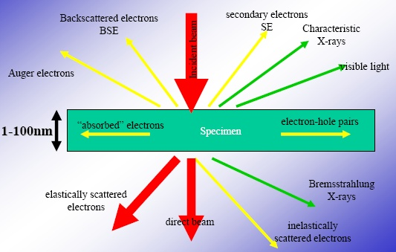
Interaction between electrons and specimen
The interaction generates a lot of signals which can be used in scanning electron microscopy (SEM) and transmission electron microscopy (TEM)

Slide 14
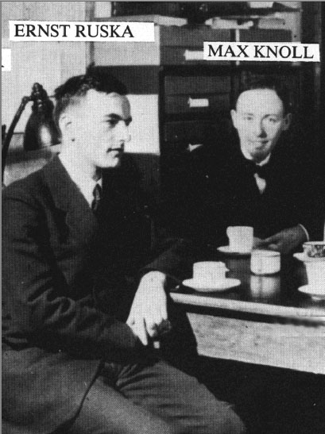
Transmission Electron Microscopy
Ernst Ruska
&
Max Knoll
1932
In Berlin-Spandau in 1932, they set up the Laboratory for Electron Optics and developed there until 1939 the first customised electron microscopes (the 'Siemens Super Microscope')

Slide 15
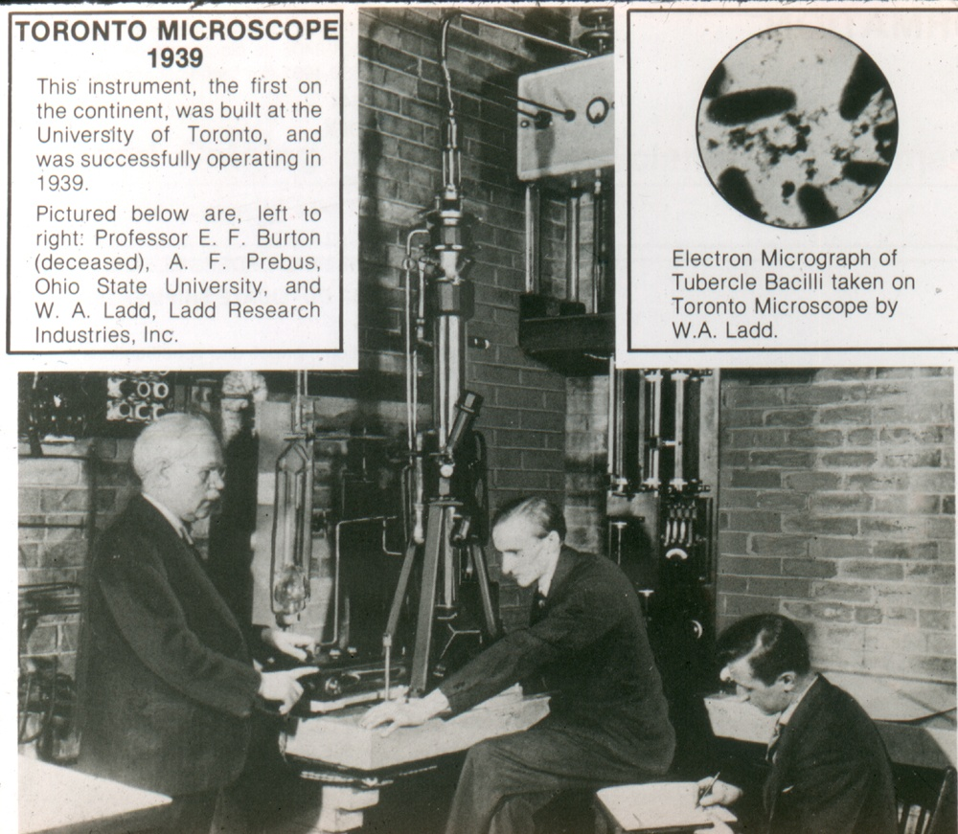
Bill Ladd
1939

Slide 16
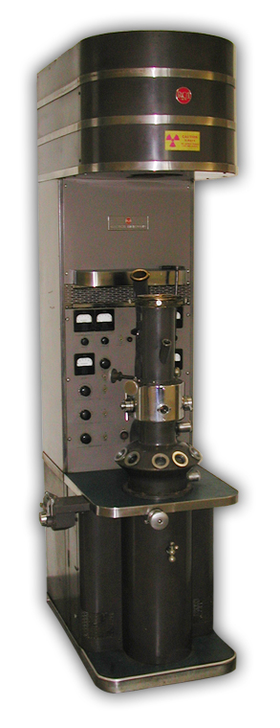
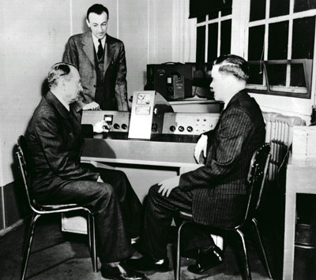
EMB
1940
James Hillier - RCA

Slide 17
Schematic Diagram of a TEM

Slide 18
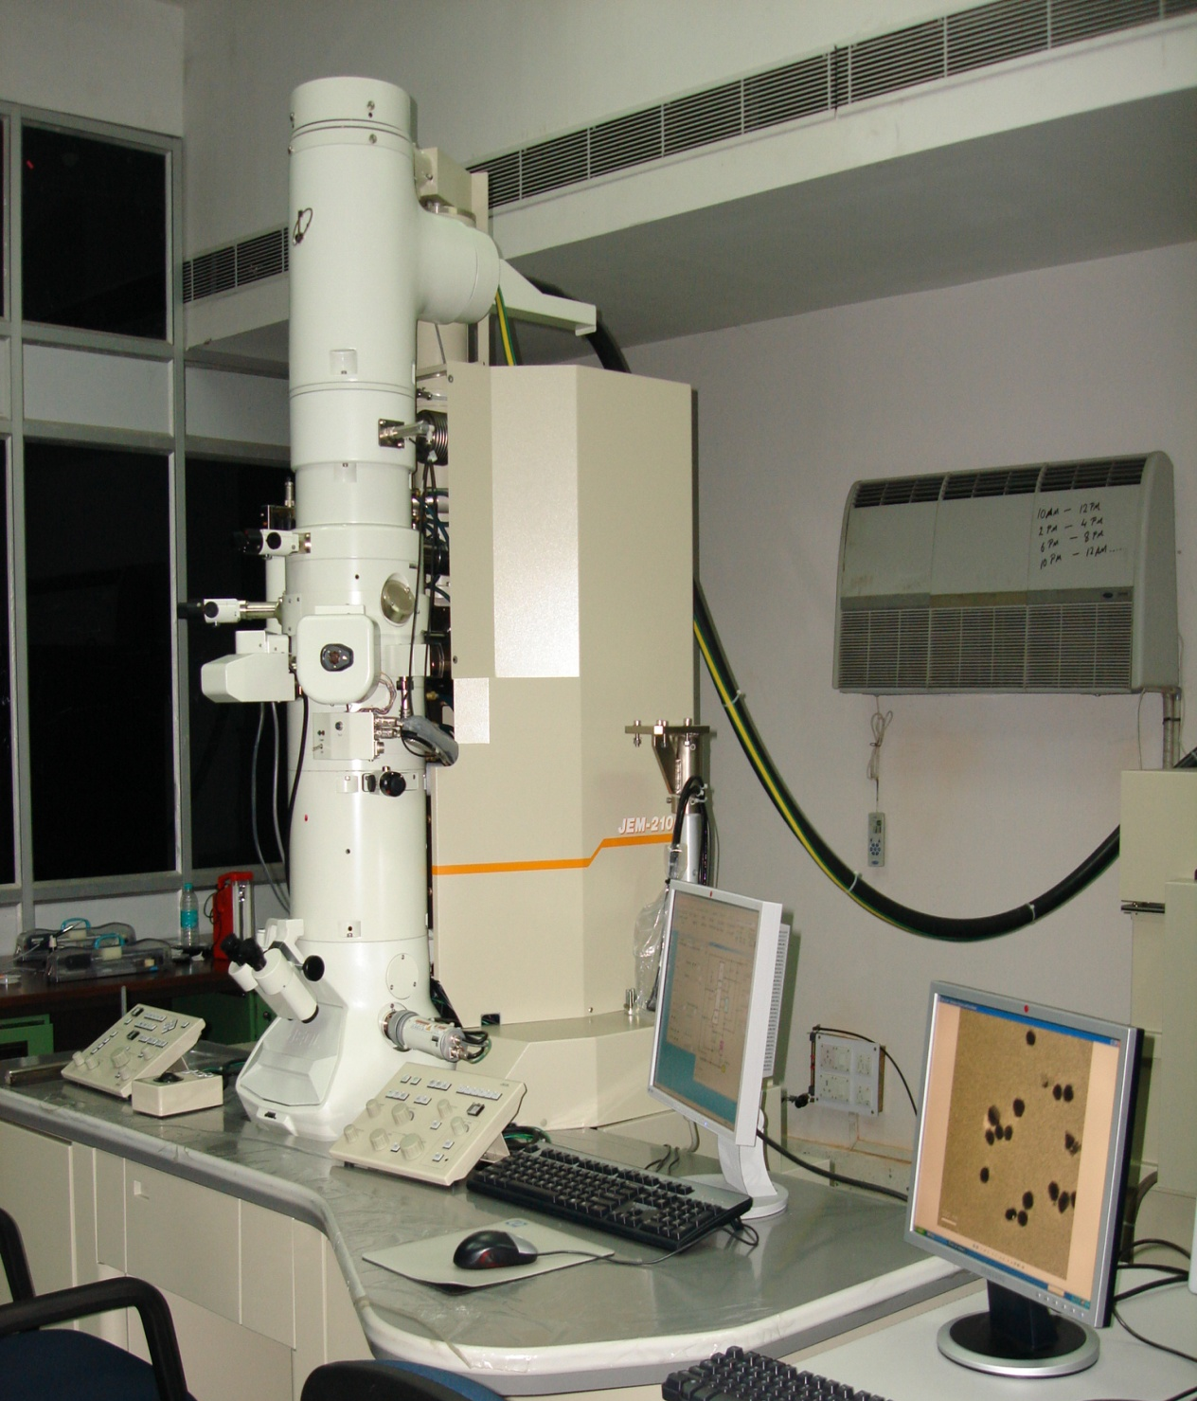
JEOL TEM
LaB₆ Cathode
Accelerating voltage: 200 keV
CCD camera
Specimen Holders
Single-tilt
Double-tilt analytical
Energy dispersive x-ray
spectroscopy (EDS)
Resolution: <0.2 nm

Slide 19
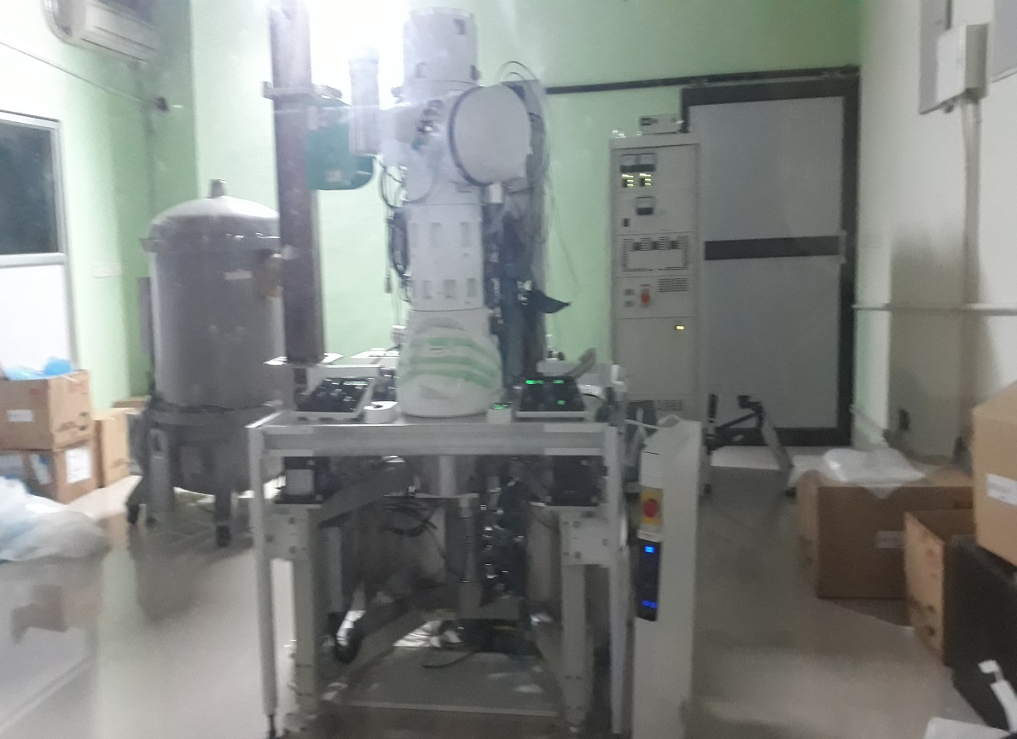

Slide 20
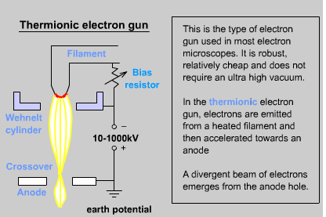
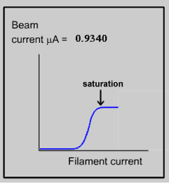
This is the type of electron gun used in most electron microscope. It is robust relatively cheap and does not require an ultra high vacuum.
In the thermo ionic electron gun electrons are emitted from a heated filament and then accelerated towards an anode.
A divergent beam of electrons emerges from the anode hole.

Slide 21
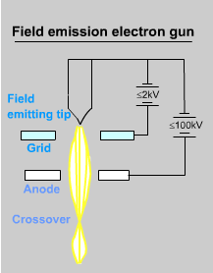
In the field emission gun, a very strong electric field (10⁹Vm⁻¹) is used to extract electrons from a metal filament. Temperature are lower than that needed for thermo ionic emission.
This gives a much higher source brightness than in thermo ionic guns, but requires a very good vacuum.

Slide 22
LENs: Magnetic or Electric
A magnetic lens consisting of a tightly wound coil and a soft iron shroud sur-rounding the coil except for a small gap. The field is concentrated in that gap. (b)
Short focal length electromagnetic
lens with pole pieces.
Magnetic lenses used in TEMs are always constructed with an iron circuit to produce a high field strength across a short gap. The magnetic fields for TEM lenses are in the range of 10,000-20,000 gauss.

Slide 23
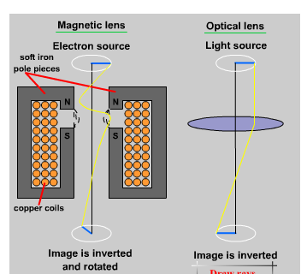
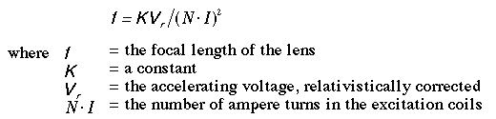
A strong magnetic field is generated by passing a current through a set of winndings. This field act a convex lens, bringing off axis rays back to focus.
Focal length can be altered by changing the strength of the current.

Slide 24
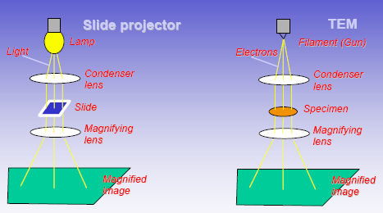

Slide 25
Diffraction Mode Image Mode
Ray diagram

Slide 26
TEM as a “multipurpose” machine
What can TEM do?
TEM Morphology
Bright field and dark field imaging Defects, Phases
Electron diffraction Structure
High-resolution imaging Defects, Interfaces, Surfaces
Convergent-beam diffraction Symmetry, Strain Lattice parameter
Energy-dispersive X-ray spectroscopy (EDX) Element analysis
Electron-energy loss spectroscopy (EELS) Electronic structures
Energy-filtered TEM (EFTEM) Imaging the distribution of
elements and even chemical states
SEM Morphology, surfaces
STEM Morphology, Z-contrast

Slide 27
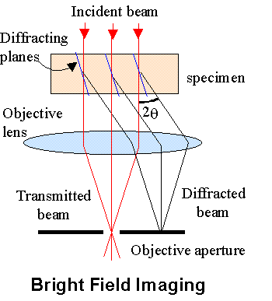
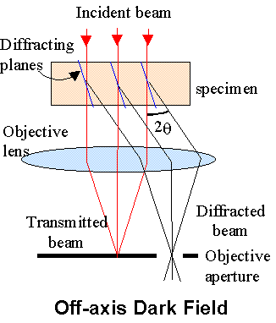
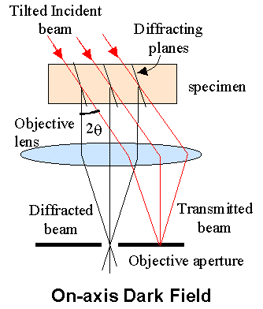

Slide 28
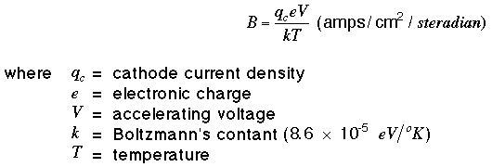
OPERATIION OF ELECTRON MICROSCOPE
BRIGHT NESS
Imaging
1- Specimen stage selection
2- Condenser aperture selection
3- Objective aperture selection
4- Focusing
5- Specimen stage selection (Repeat of 1st point)
6- Magnification choice
7- If high magnification, repeat focus …
8- Calibration of camera
9- Picture
Maintenance
1- Vacuum
2- Filament
3- Florescent Screen
4- Camera
5- Aperture and Lenses
6- High voltage source
7- Chiller

Slide 29
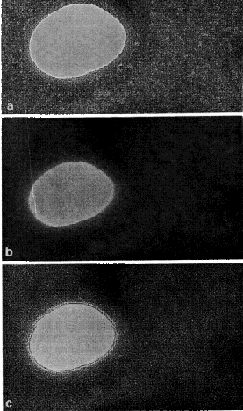
Objective lenses
Under Focus
Focus
Over Focus

Slide 30
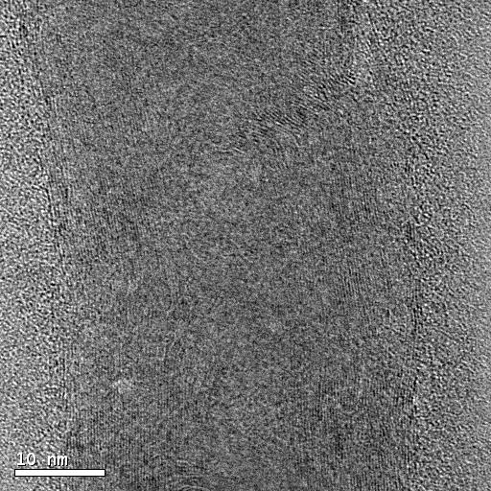
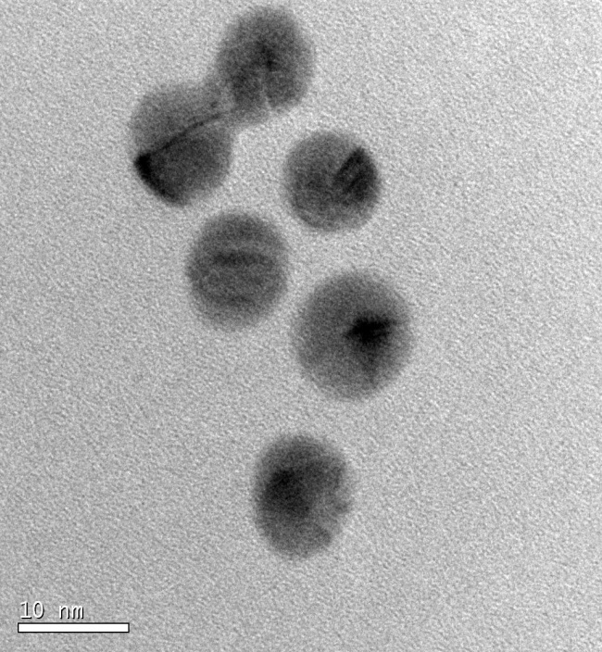
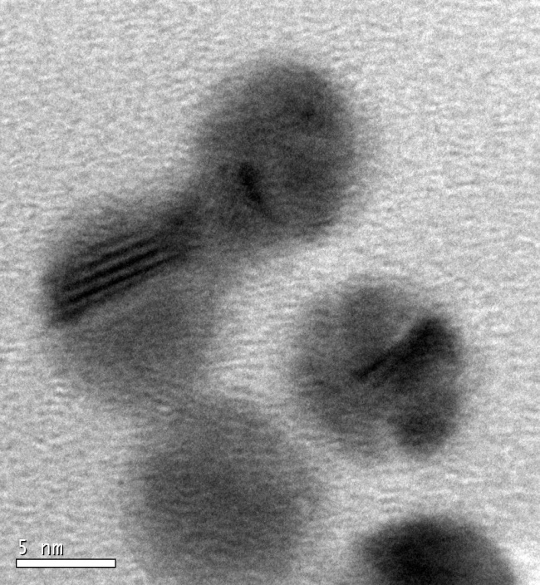
HR TEM
HR TEM
Protein
Protein
Functionalized Carbon Nanotube with Metal Nanoparticlesc

Slide 31
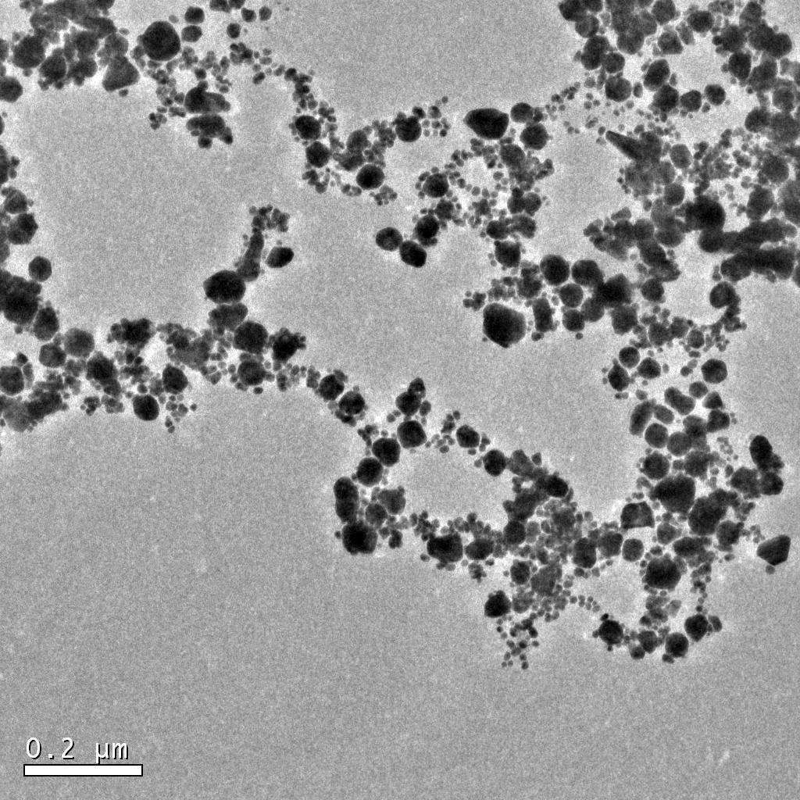
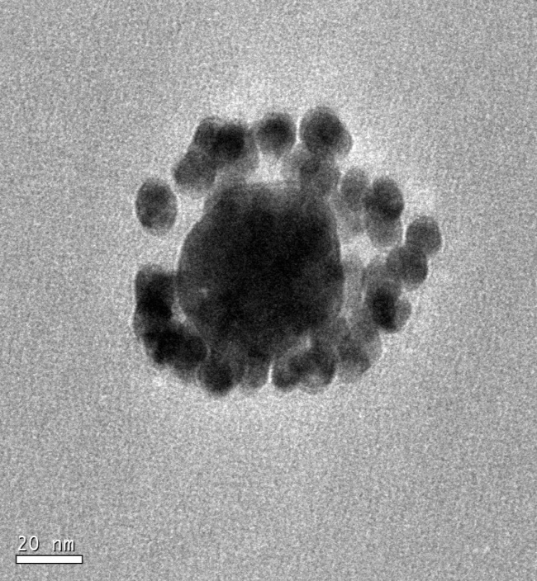
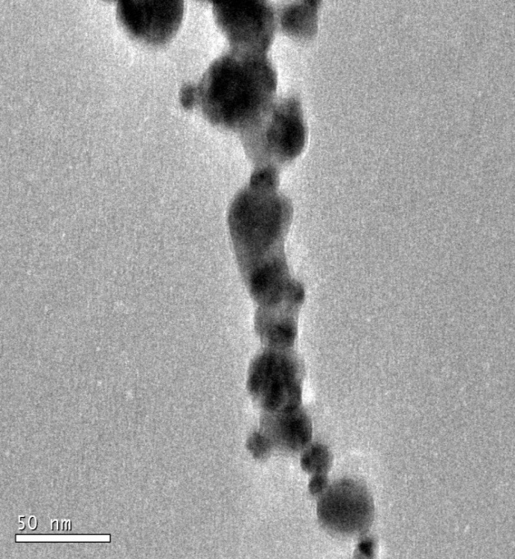
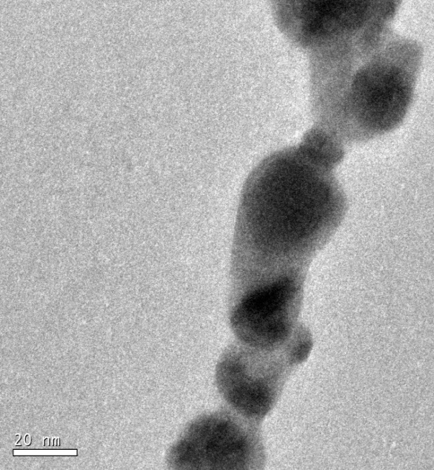
Au NP Chain
Au NP
Au NP
Au@Ag Core shell

Slide 32
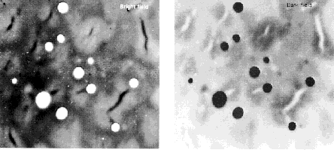
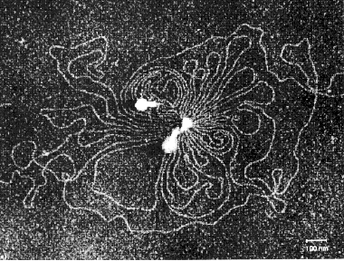

Slide 33
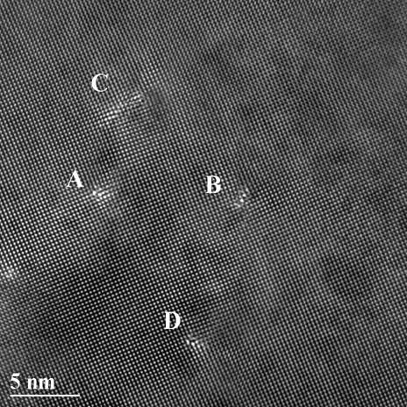
High-resolution TEM of dislocations in SrTiO₃
High Resolution Au Nanoparticle

Slide 34
Electron diffraction is a technique which allows users to determine the atomic arrangement of crystals. When combined with other analytical techniques such as EDS it can aid in the identification of unknown crystals and/or determine the d-spacing of newly described crystals.

Slide 35
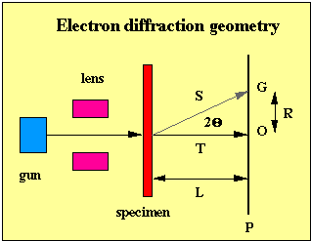
P = Photographic plane
L = distance of specimen from P
T = Forward scattered beam
O = point where T strikes P
S = Bragg diffracted beam
G = point where S strikes P
R = vector distance from O to G
R / L = tan 2θ and from Bragg’s law we know that 2dsinθ = λ.
Thus R / L = 2θ= 2λ / 2d which simplifies to
R = λ L / d If we can measure R and both λ and L are constants then d can be calculated.
2dsin 2θ =2d x 2θ = 2λ

Slide 36
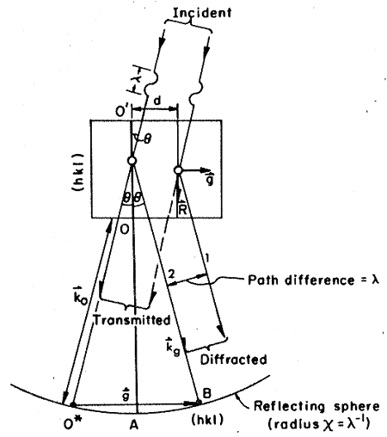

Slide 37
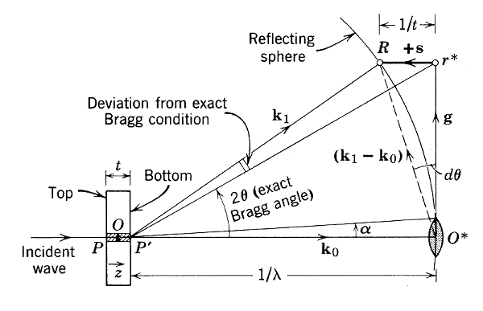
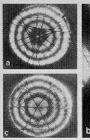
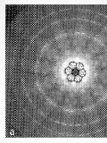

Slide 38
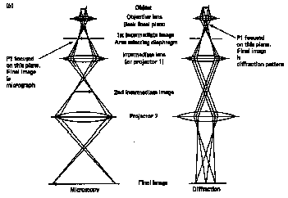

Slide 39
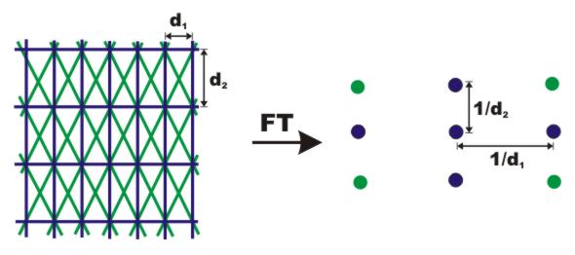
Reciprocal lattice vs Crystalline lattice in real space
Crystal structure in real space
Diffraction in reciprocal space
Thus, the distance, R on the pattern between the spot G (hkl ) and the spot O (000) is related to the interplanar spacing between the hkl planes of the crystal, d_{hkl}, by the equation: R = λ L / d.

Slide 40
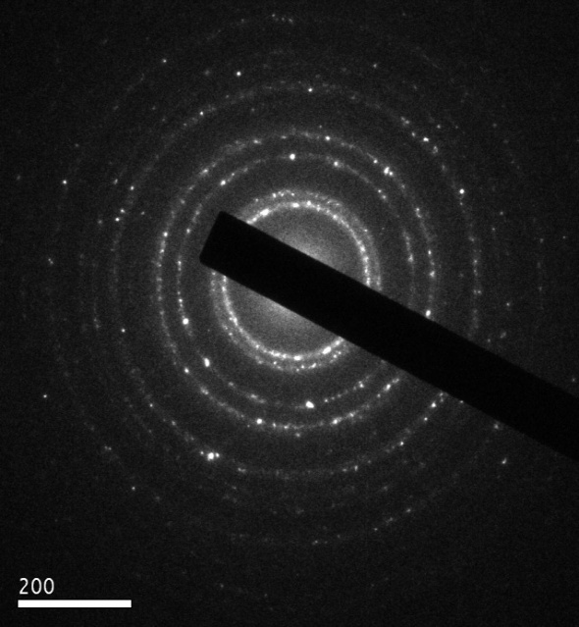
Electron Diffraction Au@Ag Core Shell
Electron Diffraction SrTiO₃

Slide 41
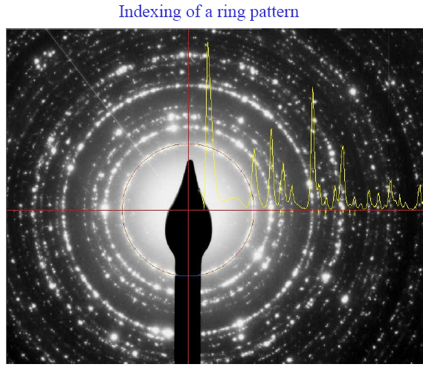
Tem Diffraction and XRD Pattern for the polycrystalline MoO₂

Slide 42
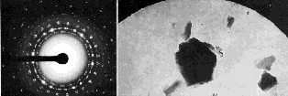
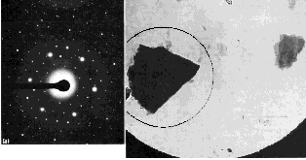

Slide 43
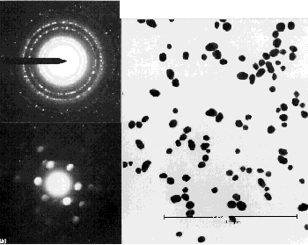

Slide 44
X-ray Energy Dispersive Spectroscopy

Slide 45
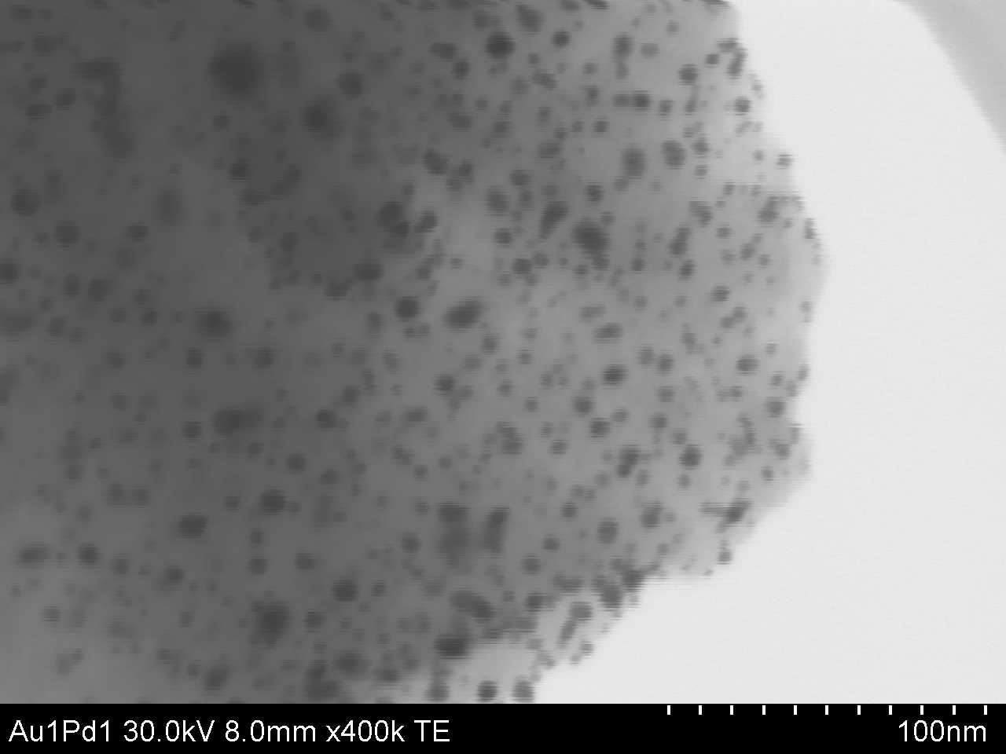
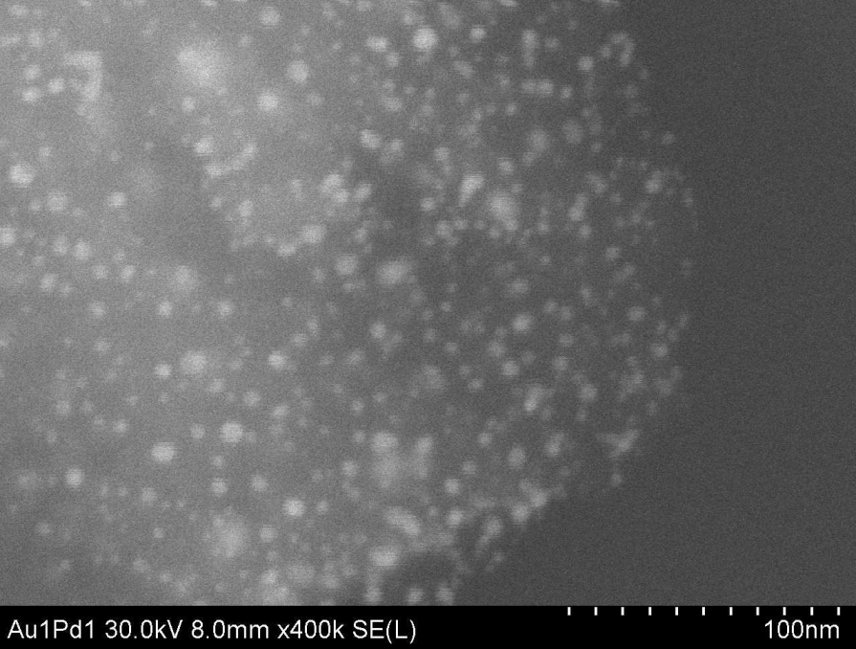
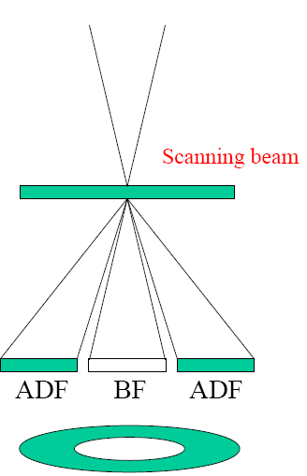
Bright Field STEM
Dark Field STEM

Slide 46
Future
We still have a long way to go before we’ve exhausted the limits of electron wavelength resolution limit.
The wave length of a high energy electron is on the order of .001nm or 1.0pm, our current best resolution with an TEM is only approximately .1nm.
Limiting factors include, aberations, contrast, etc.

Slide 47
Limitations
There are a number of drawbacks to the TEM technique.
Many materials require extensive sample preparation to produce a sample thin enough to be electron transparent, which makes TEM analysis a relatively time consuming process with a low throughput of samples.
The structure of the sample may also be changed during the preparation process. Also the field of view is relatively small, raising the possibility that the region analysed may not be characteristic of the whole sample.
The sample may be damaged by the electron beam, particularly in the case of biological materials.

Slide 48


If your sample is Powder, You are lucky enough…
Copper grids, 1.5mm center single hole, 3.05mm O. D. Hole size: ~1mm
Copper grids, 400 mesh, 3.05mm O.D. hole size: ~42um
Copper grid covered with carbon film
Copper grid
Cu, Al, Mo, Ti

Slide 49
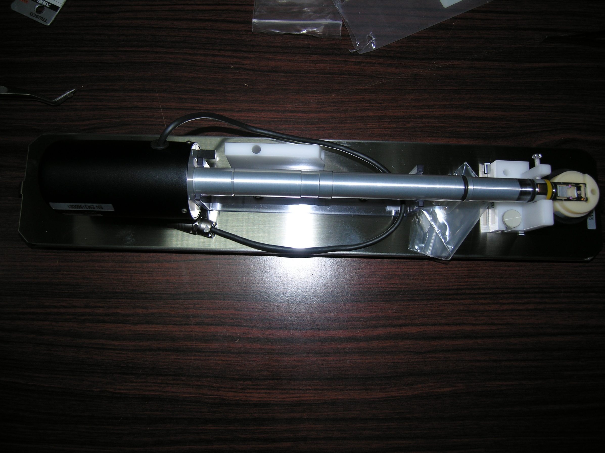
Tilt Sample Holder

Slide 50
If your sample is Solid Thin Film, Ceramic, Metal, Alloy etc.
Sample preparation
Material must be thin (< 100 nm)
High resolution requires thickness ~20 nm
Preparation methods:
– Metals can be electro polished (Precision Ion polishing)
– Semiconductors, thin films and ceramics can be mechanically thinned by dimple grinder followed by ion thinning to achieve electron transparency

Slide 51
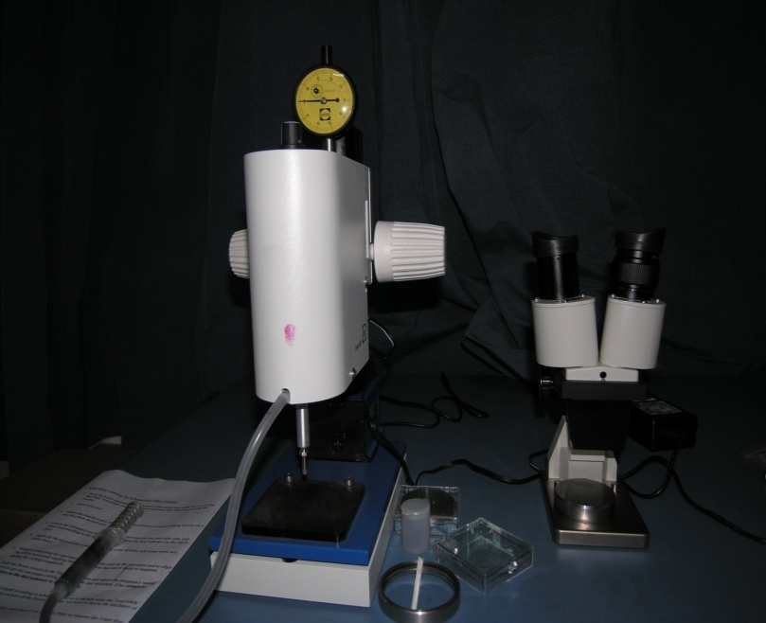
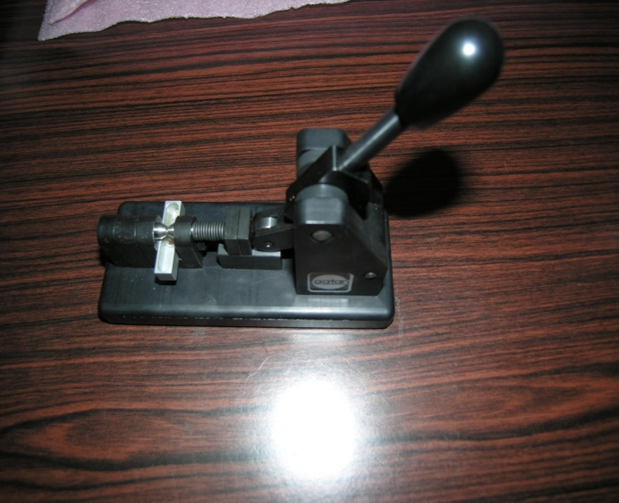
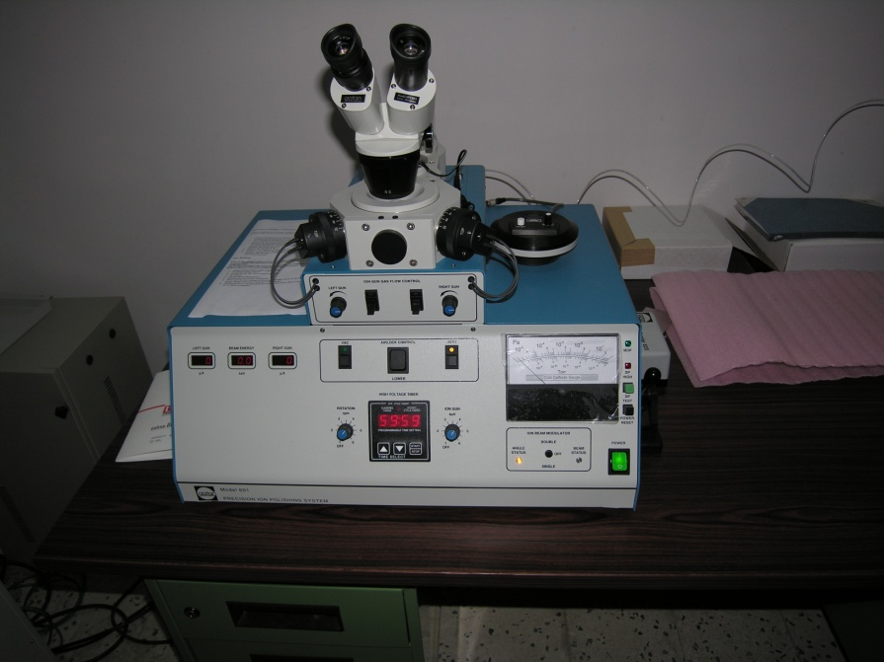
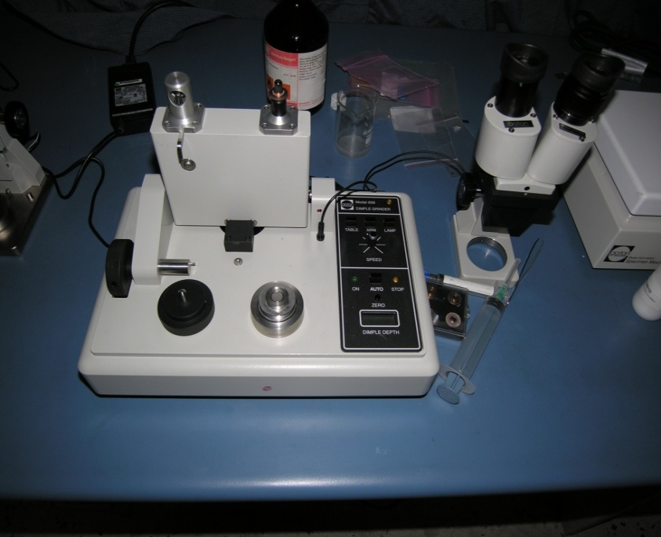
Ultrasonic Cutter
Disc Puch
Dimple Grinder
Precision Ion Polishing (PIPS)

Slide 52
Ultra-microtomy (for polymers and biological samples)
A firmly mounted specimen is moved past a fixed knife of glass and diamond.
Staining: Biological specimens are usually composed of elements that have relatively low atomic weights and in this way do not differ significantly from the embedding resins in which they are contained. To add contrast to the specimen elements of high atomic weight are used to selectively stain the biological material and impart contrast when compared to the embedding resin. Atoms of high atomic weight are better able to stop or deflect the beam of electrons whereas elements of low weight allow them to pass relatively unimpeded.
There are a number of different types of buffers that are used as fixative vehicles. They each have certain properties which make them ideal for different purposes. Although they are typically used alone or in conjunction with electrolyte additives, some can be mixed for specific applications.
Cacodylate Buffer, Collidine Buffer , Phosphate Buffers, Tris Buffer, Veronal Acetate Buffer etc.
Fixatives: Aldehydes, Glutaraldehyde

Slide 53



Ultramicrotome
Ultramicrotome With Cryo
Knife Maker

Slide 54
Review of previous classes
1. Nanotechnology in upward motion: next future of science and technology is nanotechnology
2. Constructive - Destructive interference by thin films
3. Non-Reflective Surfaces
4. Super-Hydro-Phobicity
5. Self-Cleaning
Nano in Histroy
The Localized Surface Plasmon Resonance
DICHROISM
Development of nanoscience and technology
Diversity of nano field
Surface to volume atoms of Cuboctahedral system
M(K) = (1/3)*(10K³+15K²+11K+3), K = No. of shell
N_{K} =10K² + 2, Every shell contains number of shell
SIZE EFFECT
Quantum Effect
To-Down Method of Preparation
Ball mill, Thermal, Arc discharge, Laser ablation etc.
LITHOGRAPHIC METHOD
Bottom-UP method
HOW TO REALIZE THE NANOPARTICLE ?
TEM
SEM

Slide 55
Interaction between electrons and specimen
The interaction generates a lot of signals which can be used in scanning electron microscopy (SEM) and transmission electron microscopy (TEM)

Slide 56


Slide 57

Thus an x-ray spectrum will also show characteristic x-rays arising from L to K and M to K transitions after ionization of a K electron
Usually transitions to higher shells absorbed by the filtration or are not x-rays

Slide 58
Scanning Electron Microscope
The SEM functions much like an optical microscope but uses electrons instead of visible light waves.
The SEM uses a series of EM coils as lenses to focus and manipulate the electron beam.
Samples must be dehydrated and made conductive.
Images are black and white.

Slide 59


Slide 60


Slide 61
OPERATION
There are two major challenges with operating an SEM
Creating an image requires correctly establishing different parameters
Interpreting the resulting image also requires a lot of skill and experience
Other than that, it’s really easy!

Slide 62

Imaging Inputs (operator controls)
20
15
25
100
200
40
60
40
60
10
30
50
500
20
80
20
80
5
35
100
100
1
10
1000
0
0
kV
probe current
brightness
contrast
25
20
30
1,000
10,000
24
45
15
35
100
100,000
6
90
10
40
1,000,000
5
10
1.6
180
working distance
magnification
dwell time

Slide 63


Slide 64

Leo 1430vp

Slide 66

Fibers

Slide 67

CdS

Slide 68

Bacteria

Slide 69
Ascorbic Acid: Vitamin C

Slide 70



Scanning Probe Microscope Methods

Slide 71


Slide 72
Scanning Probe Microscopy
Scanning probe methods include the following ingredients:
• A sharpened tip attached to a cantilever
• Some kind of applied force
• Physical or electrical cushioning mechanisms
• Scanning (rastering) across a sample surface
• Computerized feedback mechanisms
• Imaging software

Slide 73




Slide 74
The Lennard-Jones potential
The truncated Lennard-Jones potential
The truncated and shifted Lennard-Jones potential

Slide 75

The Force in AFM: F = -kz, k is the spring constant, z is the distance of the deflection of the cantilever
Resolution: Depends upon the radius of curvature of the tip and size of the tip

Slide 76

Mode of Operation | Force of Interaction
Contact mode | strong (repulsive) - constant force or constant distance
Non-contact mode | weak (attractive) - vibrating probe
Tapping mode | strong (repulsive) - vibrating probe
Lateral force mode | frictional forces exert a torque on the scanning cantilever

Slide 77

Piezocrystals
Piezoelectricity is the capability to generate electric potentials (electric charges) across the faces of crystals after mechanical stresses have been applied. This is an example of a strain-charge relationship.
Scanners in AFM and STM are based on piezoelectric crystals that expand and contract proportionally to an applied voltage. Precision of movement is extreme in x,y,z directions.
Usually made of zirconium titanate (PZT). +220 V to -220 V ac voltage range is typical.

Slide 78

Laser
Feedback
Electronics
Piezoelectric
Scanner
X, Y
Z
Photodiode
Detector
Cantilever & Tip
Sample
Laser diode reflects light off cantilever and into a two- or four-sector photodiode detector (A+B = total intensity, A-B = up/down motion).
Topography image formed by displaying z-motion feedback voltage necessary to maintain constant tip-sample force.

Slide 79
Types of Scanning Probe Methods
Atomic Force Methods: van der Waals
Lateral Force Microscopy (LFM)
Magnetic Force Microscopy (MFM)
Electric Force Microscopy (EFM)
Scanning Capacitance Microscopy (SCM)
Torsional Resistance Mode (TRmode)
Conductive Atomic Force Microscopy (CAFM)
Scanning Tunneling Methods: tunneling current
Tunneling Atomic Force Microscopy (TUNA)

Slide 80


Slide 81




AFM Result
CD with Nanoparticles
CD
TEM Grid
TEM Grid

Slide 82


Slide 83


Slide 84


Slide 85

Scanning Tunneling Microscopy

Slide 86

Basic principle is tunneling.
Tunneling current flows between tip and sample when separated by less than 100nm.
The tunneling current gives us atomic information about the surface as the tip scans.

Slide 87

constant tunneling current mode
Constant height mode (tip at fixed height, current change measured)
Metals: High density of states at atoms: Atoms appear as bright protrusions
Insulators: No conduction possible-> we crash
Semiconductor and thin oxides: Complex electronic structure at fermi level: be careful

Slide 88


Slide 89


Slide 90

e
2

Slide 91


Slide 92


Slide 93

STM Micrograph for Graphite

Slide 94

STM Micrograph for Graphite

Slide 95

Quantum (confined) corral
Standing wave patterns on a Cu(111) surface caused by quantum mechanical interference patterns formed from the interaction between Fe atoms and the surface plasmon of copper.

